Slide 1
New Words
Presented by
Peddi Neni Sai Kumar Naidu
51897496

Slide 2
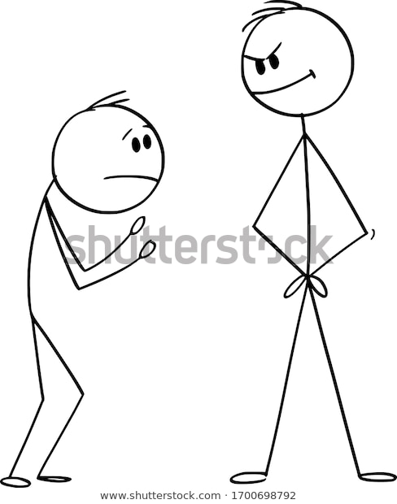
1)Cringe
Meaning: to feel embarrassed and ashamed.
He CRINGE when he unable to convey his thoughts.

Slide 3
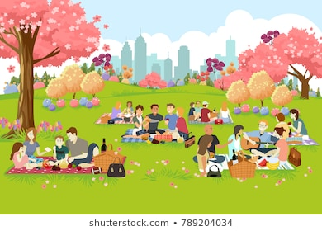
2) Stan
Meaning: To idolize love (or) big fan of (or) extreme liking.
I STAN going out with my parents

Slide 4
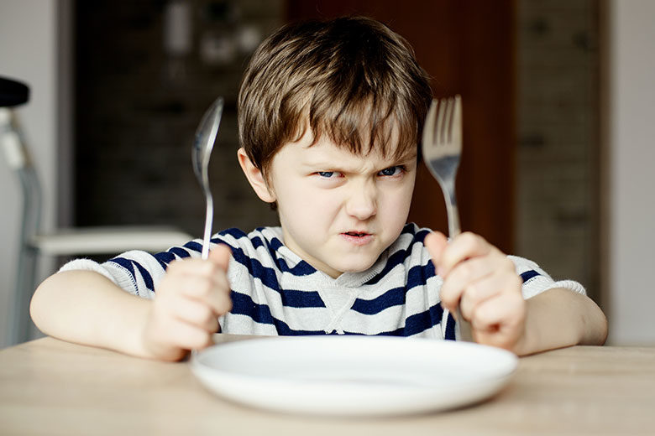
3) Hangry
Meaning: Bad temper (or) irritable result of hunger
I get HANGRY when I skip meals unintentionally.

Slide 5
